Slide 1

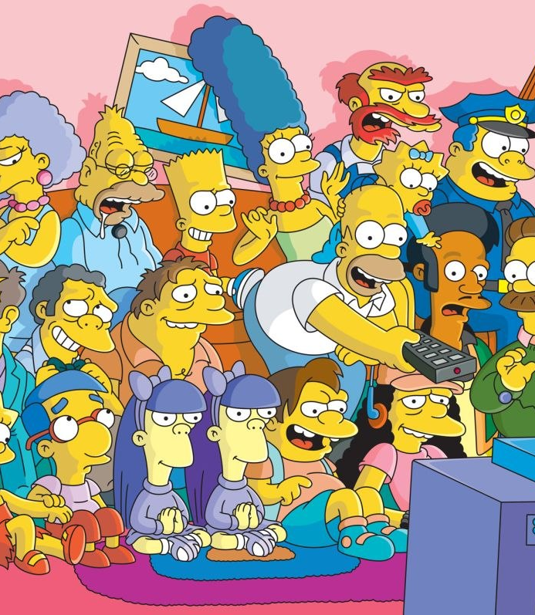
Image Detection of Simpsons Characters
DAEN 690 Project
Summer 2019
Manju Prasad, Ravi Rane, Zegang Liu, Yinchen Niu

Slide 2
Analytics / Algorithms
Sprint 3 – Week 2 Presentation
25 June 2019

Slide 3
Project Sprints
Sprint
Milestone Goals
Presentation
Problem Definition and Project Plans
Problem (decision) defined
Understanding of complexity
Potential data source identified
Potential analytics identified
Project schedule defined
Participant roles assigned
Risks identified and mitigation plan
Mid-Sprint 28 May; Full Sprint 4 Jun
Data Sets
Data located and accessed
Initial processing underway
Risks identified and mitigated
Mid-sprint 11 Jun;
Full Sprint 18 Jun
Analytics/algorithms
Algorithms defined and coded
Initial applications completed
Risks identified and mitigated
Mid-sprint 25 Jun
& 2 Jul;
Full Sprint 9 Jul
Visualizations
Visualization concepts defined
Visualization implemented
Risks identified and mitigated
Mid-sprint 16 Jul;
Full Sprint 23 Jul
Mid-Sprint 30 July;
Full Sprint 6 Aug
Final Presentations
Project components completed
Project components integrated
Project supports final decision
Presentation made

Slide 4

Project Schedule
Project Timeline:
Core Project Scope – Development.
Aided by learning Neural Networks
Notes:
Suggest we concentrate on Metadata and NLP and NOT Externals other than what results from associations between metadata and content

Slide 5
Sprint Goals
Show your research and deep dive into proposed models and algorithms.
Show the mathematics and statistics supporting your algorithms.
Show your implementations and comparison of algorithms.
Test and validate your model with actual historical observations.
Discuss what metrics you would use to assert your results.
Present your incremental and final results.
Early presentation and visualization effort.

Slide 6
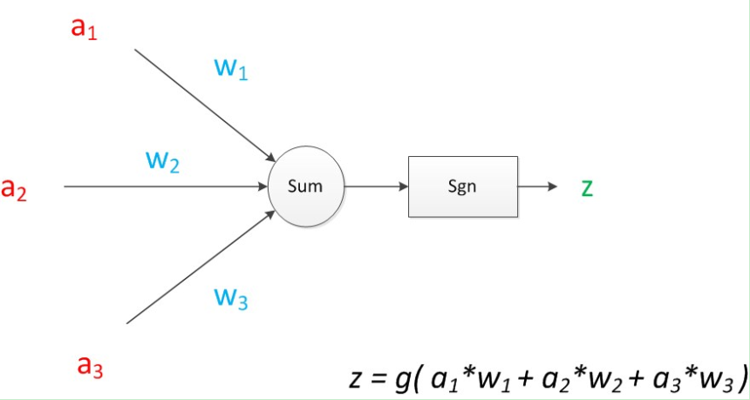
Research and Deep dive into algorithms
CNN:
A kind of artificial intelligence machine learning technology. It has three basic layers: Convolutional Layer, Pooling Layer, Flatten Layer & Fully Connected.
Based on the analysis of each character, build a model to identify each character in the simpsons
Advantages: Sharing convolution kernel, no pressure for processing high-dimensional data.
Ddisadvantages: Need a large samples. And the pooling layer may lose some valuable information and ignore the correlation between the parts and the whole.

Slide 7
Research and Deep dive into algorithms
Hybrid CNN-ELM:
Describe this.
What is it used for?
Provide advantages and disadvantages
Add a graphic
Add some math

Slide 8
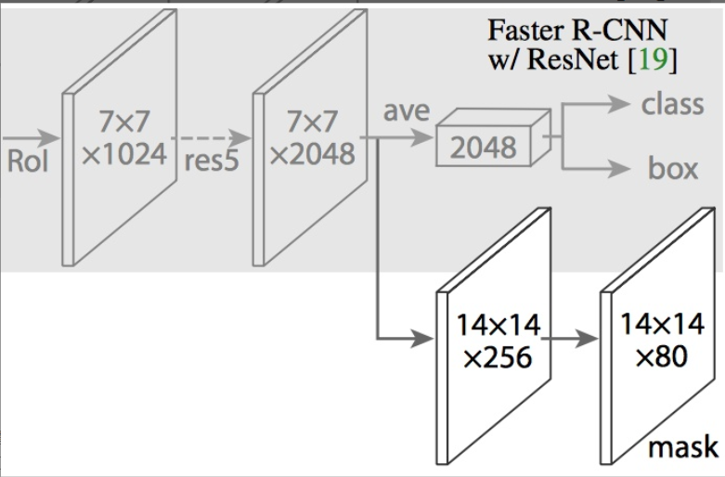
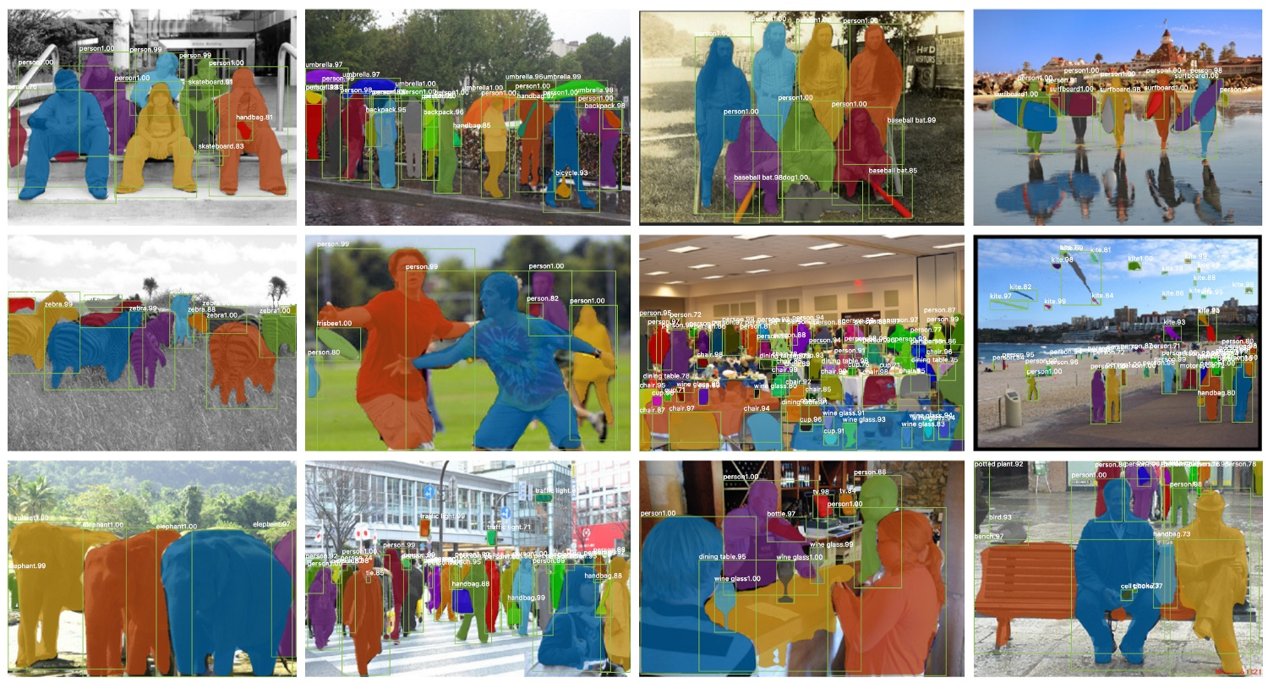
Research and Deep dive into algorithms
Mask R- CNN:
Adding a full convolution network to the top layer of CNN feature extraction layer of Faster R-CNN
Maks R-CNN adds a branch on the basis of Faster R-CNN to output a Binary Mask to determine whether a given pixel belongs to an object
RoIAlign replaced RoIPool to traverse the image, so that the selected region of RoIPool corresponds more accurately with the original image

Slide 9
Research and Deep dive into algorithms
Faster R CNN:
Describe this.
What is it used for?
Provide advantages and disadvantages
Add a graphic
Add some math

Slide 10
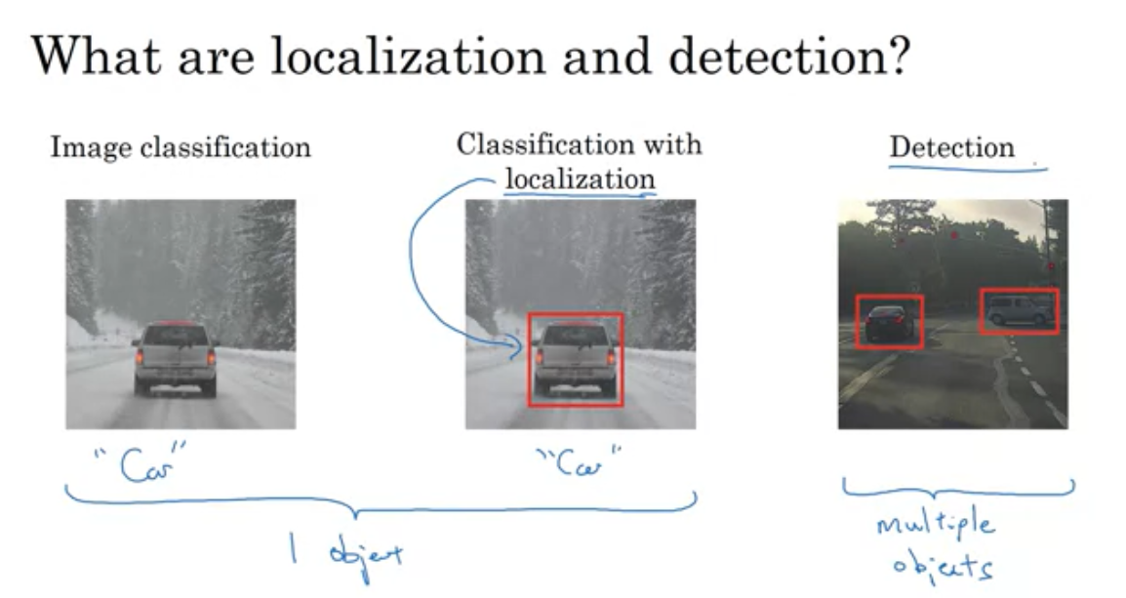
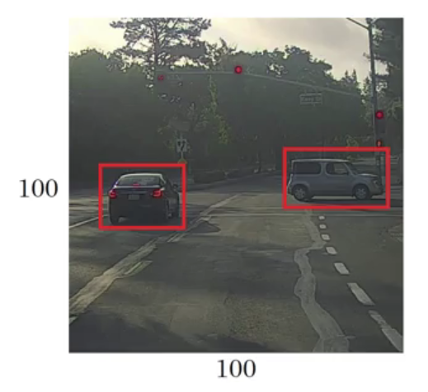
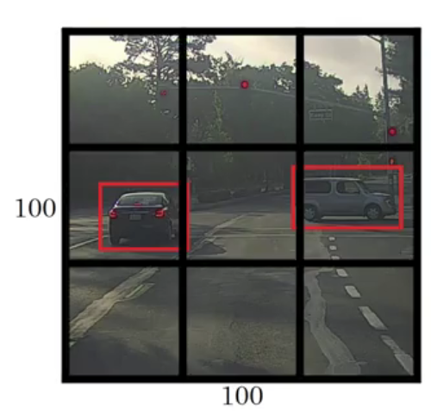
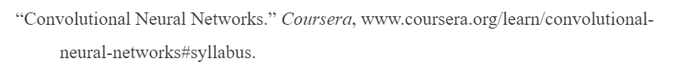
Research and Deep dive into algorithms
YOLO: (You Only Look Once) used for Object Detection – High level Steps
Classification: returns class (output)
Localization: returns class + 4 parameter related to bounded box (bx, by, bh and bw)
Detection: For each cell in grid, returns class + bounded box parameters (x anchor box)
End Goal
Step 1: Split image into grid: here 3x3
Step 2: Each cell is analyzed for mid-point of the object being detected.
Step 3: If detected, bounding boxes are calculated based on that cell.

Slide 11
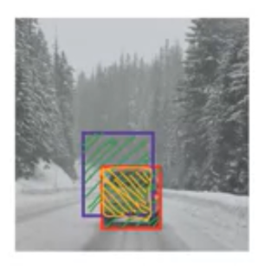
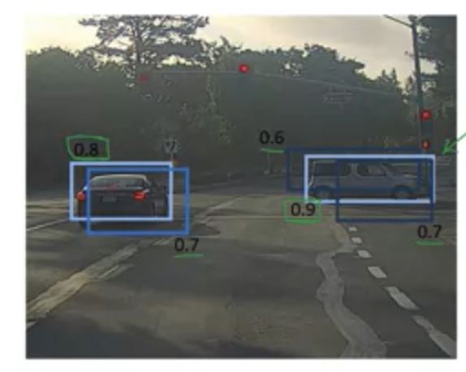
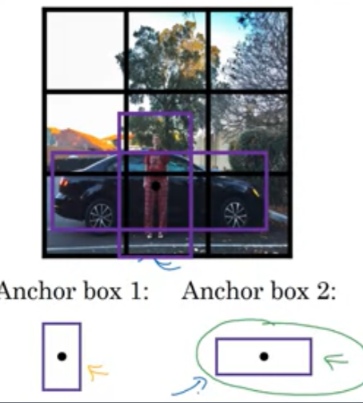
Research and Deep dive into algorithms
YOLO: Additional Notes:
Evaluate Object Localization:
IOU (Intersection over Union) : Calculates overlap between bounding boxes
and uses ratio to determine keep/discard.
Ground Truth = Red box, Algo output: Blue box
In case of multiple detections of same object, use:
Non-Max Suppression: First get rid of all boxes with Prob <6. Then choose
max Prob in a set of predictions for a particular object. Then discard all Probs
below max Prob.
In case of midpoints of objects in same cell, use:
Anchor boxes: Define 5-10 different shape of possible anchors and extend the
y output to capture different anchor shapes

Slide 12
Research and Deep dive into algorithms
YOLO:
Works with Conv Nets that perform classification and localization. Runs with one Conv Net – compared to separate run for each cell or each region. This efficiency allows for real time object detection.
Runs faster than other region based object detection architectures
Outputs better bounding boxes as box is not determined by stride size or window size of sliding windows.
Has trouble detecting multiple objects in a cell (dependent on anchors)
Use Fine grained cells for better detection

Slide 13
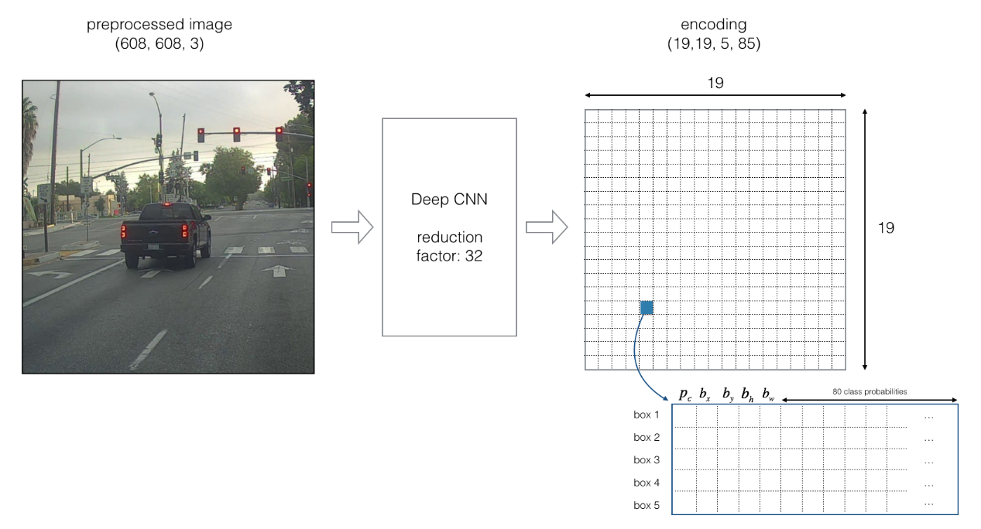
Research and Deep dive into algorithms
YOLO:
https://github.com/enggen/Deep-Learning-Coursera/blob/master/Convolutional%20Neural%20Networks/Week3/Car%20detection%20for%20Autonomous%20Driving/Autonomous%20driving%20application%20-%20Car%20detection%20-%20v1.ipynb

Slide 14
Research and Deep dive into algorithms
SSD:
Describe this.
What is it used for?
Provide advantages and disadvantages
Add a graphic
Add some math

Slide 15
Research and Deep dive – TensorBoard (Visualizing Learning)
Brief Overview
Extension of TensorFlow for visualization
Most APIs leave the user with a dilemma: the inner workings of the API are obfuscated and user either has to successfully visualize more of the neural network and input this understanding into the program or only input the less sophisticated, easier to understand portions of the neural network and deal with a confusing, far-from-ideal visualization.
TensorBoard thus makes it possible to visualize the vast quantity of layers and variables involved in deep learning on an informative, yet usable basis.
Different from other visualization tools because it actually bases much of the visualization off of the more elementary, basic structures.
Basics of How TensorBoard Works
Give TensorBoard access to the code (GitHub, Python, etc.)
Acclimate TensorBoard to the names of key variables
Define summaries (these are what TensorBoard understands and interprets when forming the visualization)
Three key coding phases (names quoted from https://www.datacamp.com/community/tutorials/tensorboard-tutorial) a. “Loading data” b. “Training” c. “Validation and Testing”

Slide 16
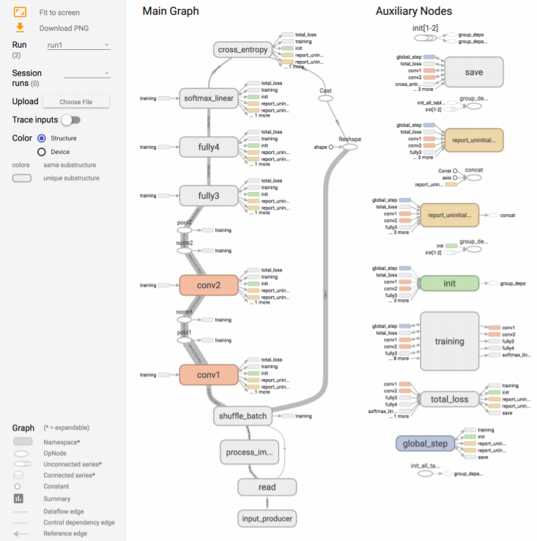
Research and Deep dive – TensorBoard (Visualizing Learning)
https://www.tensorflow.org/guide/summaries_and_tensorboard

Slide 17
Testing and Validation of models

Slide 18
Metrics used to assert results

Slide 19
Incremental Results

Slide 20
Visualizations

Slide 21
Understanding of Potential Algorithms
SafariBooksOnline
Deep Learning with TensorFlow: Applications of Deep Neural Networks to Machine Learning Task – Jon Krohn
Previous coursework material – GMU CS580 (attended by team member)
Publication/Articles
https://blog.keras.io/building-powerful-image-classification-models-using-very-little-data.html
https://machinelearningmastery.com/cnn-long-short-term-memory-networks/
https://blog.algorithmia.com/introduction-to-deep-learning/
https://link.springer.com/chapter/10.1007/978-3-030-01424-7_25
https://arxiv.org/abs/1512.03385

Slide 22
Core Goals - Algorithm Milestone Progress
Initial implementation of CNN with 4 convolution layer and one Dense layer.
Successfully ran on laptop for small dataset of Simpson images.
Execution setup for Argo is completed and tested. This is running successfully.
22

Slide 23
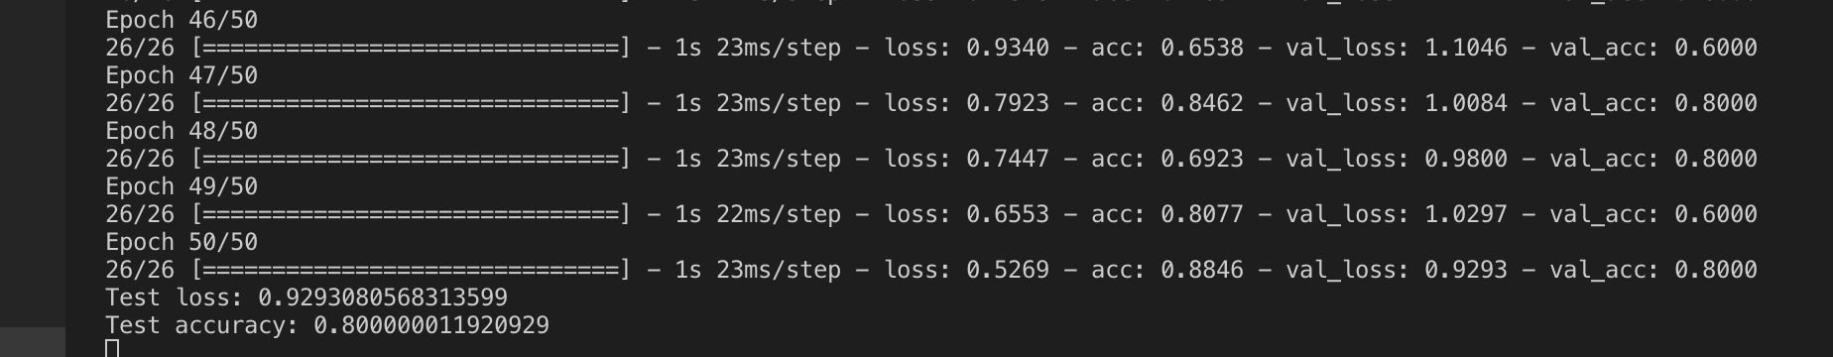
Core Goals - Execution Log
From ARGO:

Slide 24
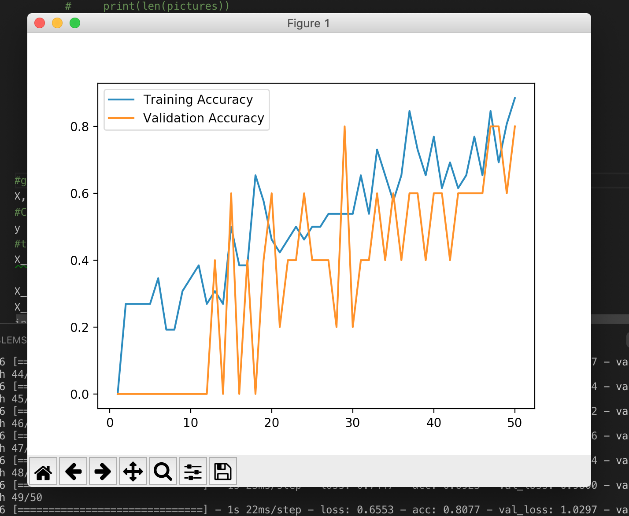
Core Goals - Performance for Small Dataset

Slide 25
Mathematics and Statistics supporting algorithms

Slide 26
Implementation and Comparison of algorithms

